Slide 1
Undergraduate Preparation for Future Teachers
Road to Teaching Conference 2015

Slide 2
Future Teacher Success Pathway
1
2
3
General
Education
Teacher
Preparation
Credential
Program
To Teach is to Touch the Future!

Slide 3
General Education
1
Provides broad exposure to multiple disciplines and forms the basis for developing essential intellectual, civic, and practical capacities.

Slide 4

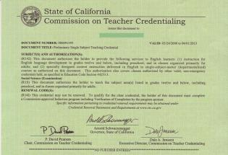
If you want to be a teacher in California, you need…
A Bachelor’s Degree + A Teaching Credential

Slide 5
Teacher Preparation Pathways
High School (diploma or GED)
Community College
Undergraduate degree program
Undergraduate degree program
Credential program

Slide 6
Teacher Preparation Pathways
GE
General Education (100-200)
Major Preparation
Major
Major coursework (300-400)
Credential program preparation
Credential
Teaching methods courses
Student Teaching

Slide 7

Teacher Preparation
2
Subject matter courses, major choice

Slide 8

What does a teacher need to know?
Subject matter
(What you learn in the courses for your bachelor’s degree)
and
How to teach
(What you learn in the credential program)
To teach is to touch the future….

Slide 9

No Undergraduate Degree in Education

Slide 10
Future Teachers Fulfill Multiple Sets of Requirements
GE
Major
Subject Matter
Preparation
Credential
Program
Prereqs

Slide 11
Multiple Sets of Requirements
For future teachers:
Major
GE
Subject Matter
Preparation
Credential Program Prerequisites
Notes:
Direct students to GE lists for elementary and/or single subject (in packets)

Slide 12
Pathways to a Bachelor’s Degree
Choose a major to suit your area of expertise:
Elementary School
Liberal
Studies
Child/Human Development
Human Services
Psychology
Sociology
Other

Slide 13
Pathways to a Bachelor’s Degree
Choose a major to suit your area of expertise:
Middle/High School
Art
English
Music
Kinesiology
Foreign Language
Social Science
Math
Science
Biology
Chemistry
Physics
Geological Science
History
Geography
Economics
Political Science
Criminal Justice
Anthropology
American Studies

Slide 14
Credential Program
3
Multiple Subject, Single Subject, and Special Education

Slide 15
What is a Credential Program?
Traditionally , a two semester program following the Bachelor’s degree; sometimes referred to as a 5th year program.
Includes student teaching
PEDOGOGY! Credential programs teach the methodology and practical applications of how to be a teacher

Slide 16
What type of credential do you need?

Slide 17

What Does a Multiple Subject Credential Authorize You to Teach?
The Multiple Subject Teaching Credential authorizes the holder to teach all subjects in a self-contained classroom, such as the classrooms in most elementary schools.

Slide 18





What Does a Single Subject Credential Authorize You to Teach?
The Single Subject Teaching Credential authorizes the holder to teach the specific subject(s) named on the credential in departmentalized classes, such as those in most middle schools and high schools.

Slide 19
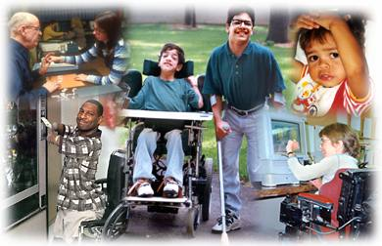
What Does a Education Specialist Credential Authorize You to Teach?
Credentials in Mild/Moderate and Moderate/Severe Disabilities authorize the provision of services to individuals in grades K through 12, and in classes organized for adults.
Early childhood special education includes the provision of educational services to children from birth through pre-kindergarten who are eligible for early intervention, special education, and/or related services under federal and state laws.

Slide 20
Steps to a credential program…
Obtain a Bachelor’s Degree
Prove knowledge of basic skills
  CBEST: California Basic Educational Skills Test
Prove subject matter competency
  CSET: California Subject Examinations for Teachers
  SMPP: Subject Matter Preparation Program (single subject only)
Complete a course in the provisions and principles of the U.S. Constitution or pass an examination given by a regionally-accredited college or university.
Complete any prerequisites and fieldwork.
Notes:
Multiple subject fieldwork – 45 hours; Single subject fieldwork – 40 hours

Slide 21
Tests!!!
Teachers have to take tests too! Don’t worry! You can do it!!!

Slide 22
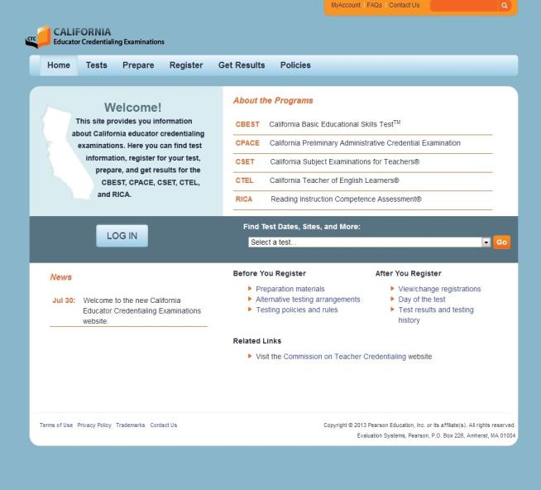
California Educator Credentialing Examinations
www.ctcexams.nesinc.com

Slide 23
CBEST
What is it?
  The CBEST is the California Basic Educational Skills Test that assesses you on basic skills in reading comprehension, math and writing skills through an 8th/9th grade level.
Who is it for?
  Anyone who wants to substitute teach or desires a career as a classroom teacher must pass the CBEST or its equivalent.

Slide 24
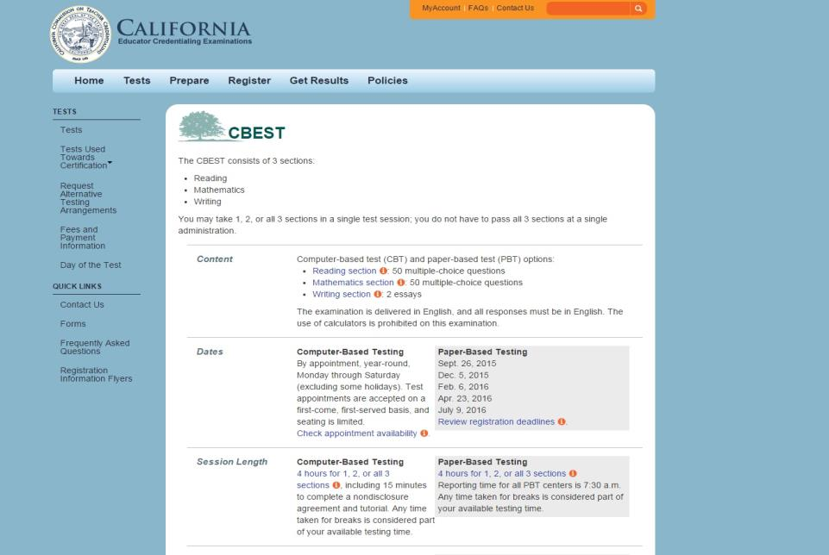
CBEST

Slide 25
Subject Matter Competency
All teachers need to prove to the Commission on Teacher Credentialing (CTC) that they “know their stuff”
  For future elementary school teachers this is done by passing the Multiple Subject CSET test.
  For future middle/high school teachers this is done by passing the CSET in your area of curriculum specialty or complete a state-approved subject matter preparation program (SMPP)

Slide 26
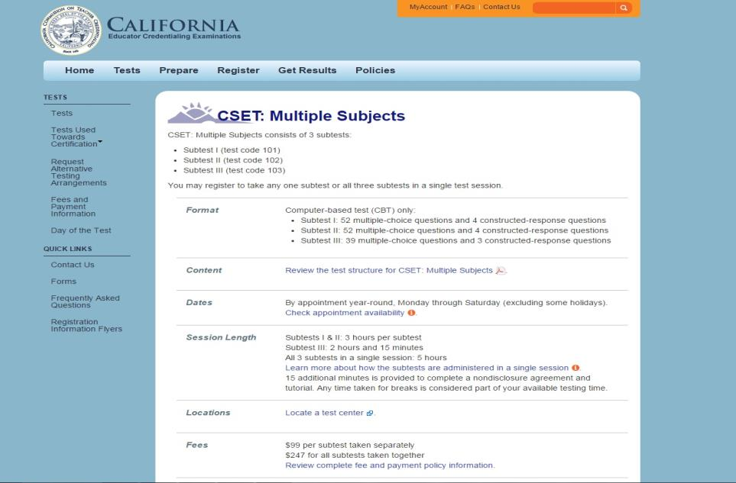
CSET

Slide 27
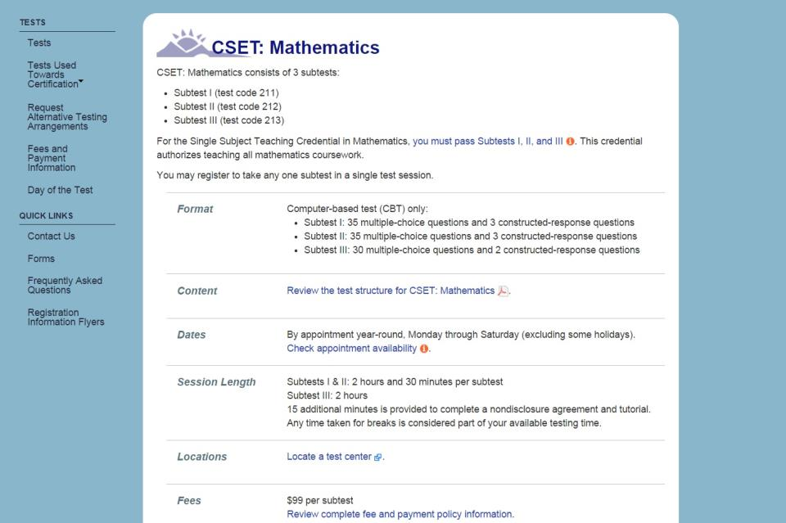
CSET

Slide 28
State Approved Subject Matter Preparation Program
Subject Matter Preparation Programs (SMPP) require students to
take classes that cover the broad range of material found in the
California Student Academic Content Standards. While most
subject matter preparation programs can be completed within
the context of the major, students must choose major electives
carefully to simultaneously complete the requirements for the
major and the SMPP. For many programs, classes are required in
addition to the requirements for the major.
SMPP = CSET

Slide 29
How Do You Prepare for the CSET?
Choose a major to help prepare you in subject matter knowledge.
Take classes to support your knowledge in the subject matter areas.
Keep and review notes, exams and papers from all subject matter classes.
Do the FREE practice test online at the CSET website www.ctcexams.nesinc.com

Slide 30
Subjects Available for Single Subject Teaching Credentials*
Languages other than English
Mathematics
Foundational Level Mathematics
Music
Physical Education
Physics
Social Science
Foundational Level General Science
Agriculture
Art
Biological Sciences
Business
Chemistry
English
Geosciences
Health Science
Home Economics
Industrial & Technology Ed.
*Check your desired university to see if the credential you seek is offered

Slide 31
Credential Program Prerequisites
Check with the universities you are interested in attending to see what are their specific prerequisites as they vary from school to school.
Some universities offer blended programs where you can earn your bachelor’s degree and teaching credential at the same time. Others may offer blended programs where you earn your teaching credential and Master’s degree at the same time.
Many universities offer their credential programs as a 5th year program completed the year after the bachelor’s degree.

Slide 32
Choosing the Right Program for You
Important things to consider
  Combined Bachelor’s degree and Credential
    Post-baccalaureate course work recognition
  Combined Credential and Master’s Program
    The Myth: Districts won’t hire with a Master’s
    Master’s Degree as Professional Development
    Personal & Professional Opportunity

Slide 33
Choosing the Right Program for You
Important things to think about
  Cohort v. non-cohort
  Cost

Slide 34
Cohort v. Non-cohort
Credential Programs
Just like degree programs are structured differently from university to university, so are credential programs!
Some universities have structured their Multiple Subject and Single Subject Credential Programs to follow a cohort format:
  A cohort is a learning community in which all classes for the credential program contain the same students each semester.
  Each semester is specifically structured, the classes are arranged in a particular format, and you are guaranteed that you will be able to register for all of your classes.

Slide 35
Cohort v. Non-cohort Credential Programs (cont.)
  You build strong relationships and support structures with the other students and faculty members in your cohort.
  Limits ability to work outside program hours.
Non-Cohort programs:
  Non-cohort programs are a little more flexible in regards to how you arrange your schedule and how many classes you take at a time.
  Allows more time to work outside program hours.
  May offer online options for course work.
  Program time completion varies.

Slide 36
Credentialing Costs
Cost is an important factor when deciding on a credential program
For academic year 2015-2016
  $3658 (sem.) / $7316 (yr.)@ CSUF (2 semesters)
  $3664 (sem.) / $7328 (yr.) @ CSULB (2 semesters)
  $2625 (quar.) / $7875 (yr.) @ CalPolyPomona (3 quar.)
  $5498 (quar.) / $16,463 (yr.) @ UCI (3 quarters)
  41credits@$840 per credit / $34,440 (18mos.) Chapman Univ.

Slide 37
Financial Aid Opportunities
  Direct Loans and Federal Stafford Loan
    Forgive $5000-$17500: www.federalstudentaid.ed.gov/tc
Loan Cancellation Program
  Federal Perkins Loans: may cancel up to 100% of loan www.federalstudentaid.ed.gov/tc
TEACH Grant (Teacher Education Assistance for College and Higher Education) – http://studentaid.ed.gov
  K-12 public/private school
  May be awarded up to $4,000/yr.
  Full-time teacher in “high need field” and low-income area for 4 academic years (within 8 years of graduating)

Slide 38
Questions?
Current High School Students - See a counselor
Current Community College Students – See a counselor( preferably in the Teacher Education program)
Current University students – See major advisor and/or teaching pathway advisor. www.fullerton.edu/cct
Teaching is a work of

Slide 39

Caren Bautista
STEM Teaching Coordinator
California State University Fullerton
Center for Careers in Teaching
(657) 278-3368
cbautista@fullerton.edu

